Slide 1

C&I LEASING PLC
Investor Forum
8 November 2018

Slide 2
Outline
1
4
About C&I Leasing Group
2
9M 2018 Financial Snapshot
12
3
Group Financial Performance Review
16
4
Strategy & Outlook
24
5
Appendix
27
5

Slide 3
About C&I Leasing Group
Andrew Otike-Odibi

Slide 4
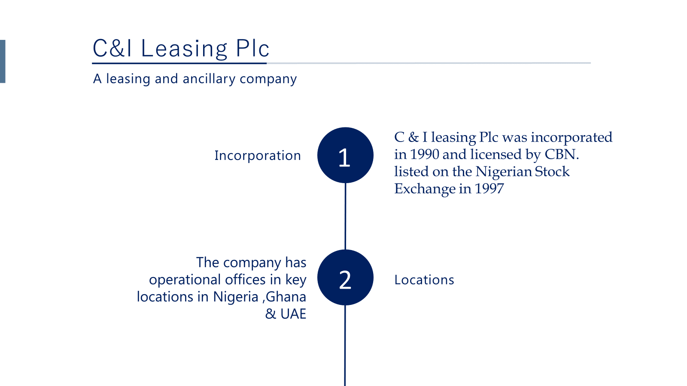

Slide 5
3
Staff strength
About 5,000 persons
(Outsourced and core staff)
Our brand presence can be felt in major sectors in the Nigerian economy, providing specialized services from Oil & Gas to Telecoms, Hospitality, FMCG, Finance etc.
4
Operations
www.c-ileasing.com
info@c-ileasing.com

Slide 6
C & I Leasing Group
Subsidiaries
Ghana
Leasafric
71%
UAE
EPIC FZE*
100%
Nigeria
C& I Leasing Plc
100%
Business Units
Fleet Management
Marine
Fleet Management
Personnel Outsourcing
Marine
*EPIC FZE is incorporated in the free trade zone of UAE for tax benefit purposes. All the vessels and operations are in Nigeria.
.

Slide 7
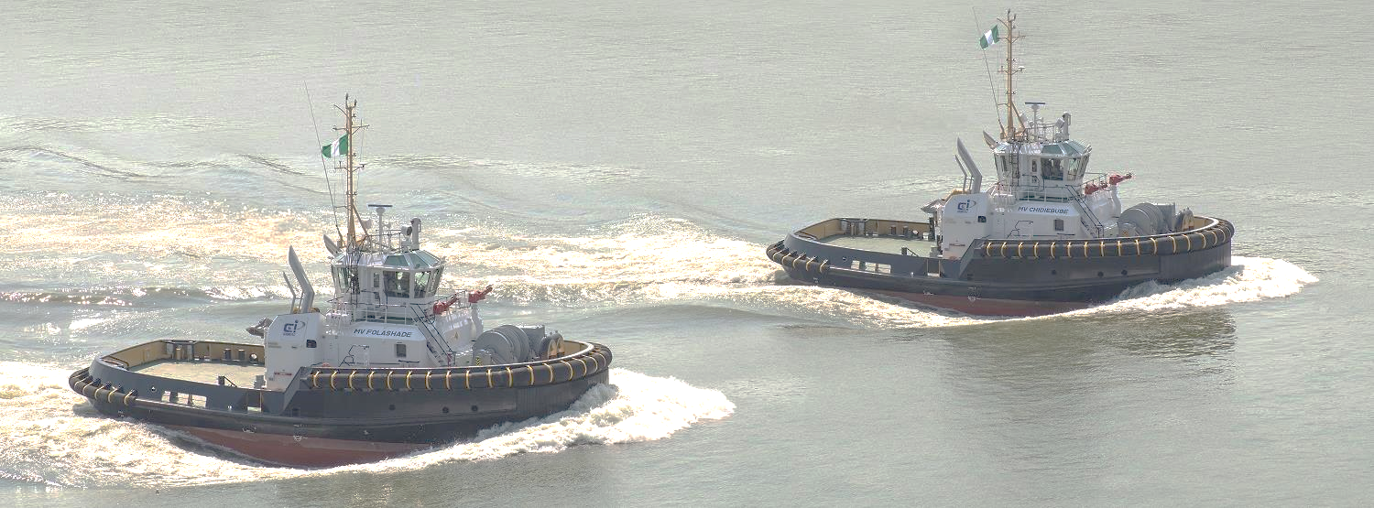
Current Marine business
C&I Marine is a division of C&I Leasing Plc that manages and operates all the offshore support vessels and related marine services contract with oil majors in the Nigerian offshore sector.
20 owned vessels on long term fixed contract (2 new vessels were deployed in October 2018 for 10-15years fixed contract)
6 vessels on charter
We are also exploring new opportunities on various new contracts i.e. Dangote Refinery/COOEC contract & provision of 3 tugs + 3 barges to COOEC
www.c-ileasing.com
info@c-ileasing.com

Slide 8
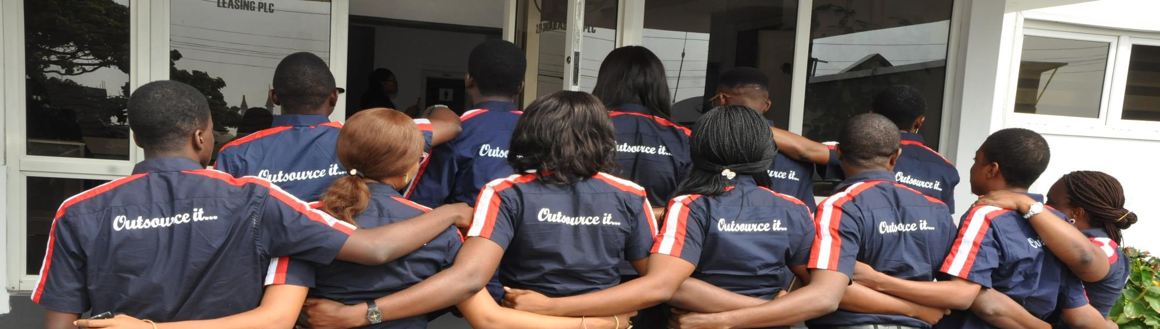
Outsourcing
C&I Outsourcing business
C&I Outsourcing Ltd is a licensed provider of manpower recruitment, training, personnel outsourcing and human resource consultancy services.
We currently manage over 5,000 professionals(monthly turnover slightly above ½ billion) that are spread across several industries, including, Oil & Gas, Telecommunications, Banking, manufacturing and Agriculture to mention a few.
www.c-ileasing.com
info@c-ileasing.com

Slide 9

Fleet management & Car rental business
The company currently manages over 1,500 vehicles with professional chauffeurs around the country; offering operate and maintain services on 3-4 year fixed contract with blue chip companies, pool car services, pick up and drop off, Airport shuttle and daily rental services.
Hertz Rent-A-Car. We are the sole franchisee and operator of the popular Hertz-Rent-A-Car brand in Nigeria.
The company was recently awarded a N4.3 billion fleet management contract for 3 years. The contract commences from November 2018
www.c-ileasing.com
info@c-ileasing.com

Slide 10

Leasafric Ghana
Leasafric is a subsidiary of C&I Leasing Plc, in Ghana.
It is the largest leasing company in Ghana and provides professional lease options for individuals and corporate bodies with fleet size over 1,000 vehicles
www.c-ileasing.com
info@c-ileasing.com

Slide 11
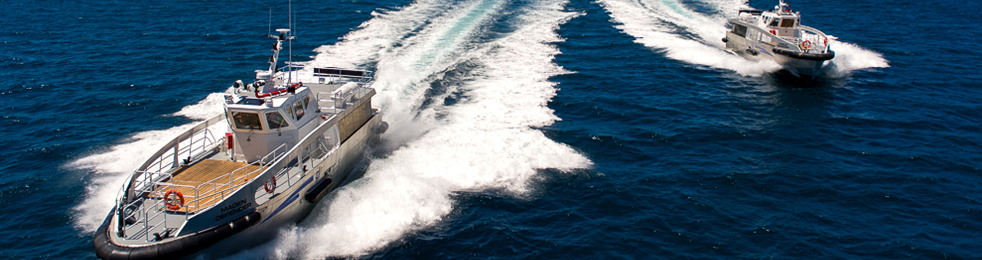
Epic International FZE - UAE
The company was incorporated on 15th June 2011, as a free Trade zone establishment in United Arab Emirates and licensed to trade in supply of vessels, its parts, component and automobile.
Through EPIC, we have been able to take advantage of cheaper sources of financing available internationally for financing our offshore vessel support business.
www.c-ileasing.com
info@c-ileasing.com

Slide 12
Breakdown of business segment for C&I Leasing Plc (Company)
Personnel
Outsourcing
Fleet
Management
Marine
Leading Nigerian Content player in the offshore marine vessel space. It offers a wide range of marine services to both onshore and offshore terminals; leveraging the opportunities created by the Nigerian Oil and Gas Industry Development Act for indigenous companies
Human resource solutions (personnel management, human resource outsourcing, consultancy, personnel evaluation) for blue chip organizations in addition to the SDS training center which focuses on training services
Providing Car rental services with its Hertz Car Rental franchise, as well as fleet management services for light vehicles and heavy duty automobiles. Also providing web-based, end-to-end tracking and other fleet management solutions to both internal and external clients

Slide 13
An industry with good growth prospects
Leasing industry expected to blossom, owing to the various initiatives of Government aimed at reflating the economy and the increasing relevance of leasing to capital formation
Focus on agriculture will create an extensive market for the leasing business, as a whole range of equipment would be required across the Agric value chain, from planting, harvesting, processing and storage to distribution
Special focus on infrastructure will open up business opportunities for the leasing industry as specialised and general equipment would be needed to support the massive construction that would take place in the rail, roads, power, housing etc
Manufacturing sector including the micro, small and medium enterprises (MSMEs) will equally present enormous opportunities for leasing, as the demand for assets for productive ventures is expected to continue to increase
other emerging opportunities to be tapped in the healthcare and education sectors
Non-availability of long-term, low-cost funding has contributed majorly to the decline of equipment leasing in the country. Expensive funding, high importation cost of equipment, default in payment in terms of fatigue, fraudulent practice and poor Credit bureau remain key problem areas
In view of depreciation in exchange rate
  lease pricing is much higher, further discouraging potential clients
  Reflecting is also much more expensive given significant increase in cost of new vehicles, with resultant extension of depreciation period and higher maintenance
Fraudulent practices by the lessee is another unfavourable challenge to lease development such as tampering with mechanisms of the assets on lease, simultaneous multiple lease financing and default in the rental payment arising from payment fatigue and others
Opportunities
Challenges/Threats

Slide 14


A solid investment proposition focused on long-term growth
High quality borrower
Strong and stable management team
Strong competitive positioning across all segments
Good security structure
Transparent structure of revenue flow from lease assets to meet specific repayment obligations of borrowings used to fund relevant assets provides platform for growth
Able to achieve lower weighted average cost of funds than the market
Allows the Group to continue to expand in a sustainable and profitable way
Long-term relationships with A-rated clients
Operating in segments with sound market potential
Predictable cash flows
Significant infrastructure to grow the business
Providing emerging growth opportunities
Allowing for visibility of earnings and business planning
Highlighting strong barrier to entry to the sector

Slide 15























Client snapshot: C&I Leasing PLC has a diversified and high-quality client base
Revenues by sector for 9M 2018

Slide 16
Overview of the C&I Leasing Group structure
Parent Company
C&I Leasing Group
Subsidiaries
Ghana: Leasafric (71%)
(89 staff)
UAE: Epic FZE* (100%)
Nigeria: C&I Leasing Plc (100%)
(553 staff)
Business Units
Fleet Mgt
PBT: N188.8mm
ROE: 10%
Marine
PBT: N1013.9mm
ROE: 31%
Fleet Mgt**
PBT: N326.5mm
ROE:26%
Personnel Outsourcing
PBT: N221.6mm
ROE: 10%
Marine
PBT: (N462.0mm)
ROE: (20)%
*EPIC FZE is incorporated in the free trade zone of UAE for tax benefit purposes. All the vessels and operations are in Nigeria.

Slide 17




Overview of EPIC FZE (UAE) and Leasafric (Ghana)
EPIC FZE
Leasafric
Marine
Fleet Management
EPIC trades in ships and boats, its parts, components and automobile. It is incorporated as a free zone establishment under a license issued by Al-Khaimah free trade zone, Ras Khaimah, U.A.E. The establishment is registered under UAE Federal Law NO(8) of 1984 and 1988 as amended.
Leasafric currently has a fleet size of over 900 vehicles with a wide network of clients across the Oil and Gas Industry, Power Sector, Telecommunications, FMCG* and Mining industries. it is the largest provider of outsourcing and fleet management services in Ghana.
EPIC FZE: Gross Earnings Evolution (N, billions)
Leasafric : Gross Earnings Evolution (N, billions)
N6.0bn
N6.0bn
N3.9bn
*Fast Moving Consumer Goods

Slide 18
9M 2018 Snapshot
Alex Mbakogu

Slide 19
Improving macroeconomic and regulatory environment but challenges persist
GDP y-o-y growth (%)
Inflation growth rate (%)
Crude Oil Price/Barrel ($)
Exchange rate (N/$)

Slide 20
9M 2018 key highlights
Gross earnings of N19.9 billion, up 15.6% y-o-y, driven by an increase in lease rental income (+17.5%), representing 70% of the total gross earnings for the nine months period, on the back of volume increase in the fleet and marine business
Net operating income of N5.7 billion, up 8.6% y-o-y as a result of improvements in all segments of the business
Profit after tax of N1.2 billion, up 25.0% y-o-y, on the back of increased efficiency from all the business units as well as improvement in capacity utilisation of both marine and non-marine assets
Basic earnings per share of 73.45 kobo, up 25.0% y-o-y, due to higher earnings
The Marine business acquired two new Tugboats’ named ‘MV Chidiebube’ and ‘MV Folashade’ with SIFAX MARINE LIMITED under the SIFAX C&I MARINE LIMITED joint venture arrangement. Both boats commenced work at the beginning of Q4 2018 with NLNG on a long term contract
Year-to-date total assets up by 29.2% to N58.1 billion, largely driven by growth in operating lease assets, proceeds from Bond issuance, trade, and finance leases, as well as other receivables and prepayments

Slide 21
9M 2018 key performance indicators
Gross Earnings
N19.9 billion
Total Assets
N58.1 billion
15.6%
29.2%
9M17: N17.2 billion
FY17: N45.0 billion
Cost to Income Ratio
39.2%
Total Debt
N35.0 billion
10bps
21.1%
9M17: 49.2%
FY17: N28.9 billion
EBITDA margin
36.5%
Shareholder’s Funds
N10.0 billion
10bps
10.1%
9M17: 36.4%
FY17: N9.1 billion
Net Operating Income
N5.7 billion
Leverage*
3.2x
8.6%
nm
9M17: N5.2 billion
FY17: 3.0x
Basic Earnings per Share
73.45 kobo
Return on Equity
11.9%
25.0%
20bps
9M17: 58.75 kobo
Price Earnings Ratio
4.08
380.0%
9M17: 0.85
*Net Interest Bearing Liabilities /Equity

Slide 22
Group Financial Performance Review

Slide 23
Demand for the Fleet and Marine Services drive top line growth
Income Statement Highlights (N’000)
 | 9M 2017 (N’000) | 9M 2018 (N’000) | % Δ
Gross Earnings | 17,181,695 | 19,862,408 | 15.6%
Lease Rental Income | 11,812,780 | 13,885,166 | 17.5%
Outsourcing Income | 4,490,786 | 4,957,371 | 10.4%
Lease Rental Expense | (4,768,739) | (6,338,634) | 32.9%
Indirect Operating Expenses* | (1,872,406) | (1,854,379) | -1.0%
Net Operating Income | 5,227,338 | 5,676,626 | 8.6%
Profit/loss before tax | 1,157,261 | 1,288,783 | 11.4%
Profit/loss after tax | 950,023 | 1,187,670 | 25.0%
Gross earnings increased by 15.6% to N19.9 billion from N17.2 billion in 9M 17 driven by the growth in lease rental income (+17.5% y-o-y), on the back of volume increase in the fleet and marine business
Rise in revenue from the fleet and personnel businesses mainly due to the expansion in existing and new contracts following continuous demand for our services
Net operating income increased by 8.6% as a result of improvements in all segments
9M 2018 profit after tax increased by 25% y-o-y on the back of increased efficiency from all the business units as well as improvement in capacity utilisation of both marine and non-marine assets
*Normalised to exclude FX loss

Slide 24
Improving performance despite the challenging operating environment
Gross Earnings (N, billions)
+15.6%
+25.7%
  Gross earnings increased by 15.6% from N17.2bn in 9M17 to N19.9bn in 9M18 driven by :
  The growth in lease rental income (+17.5%), representing 70% of the total gross earnings for the nine months period, on the back of volume increase in the fleet and marine business
  Increase in personnel outsourcing earnings by 10.4% to N5.0 billion in Sept 2018 (9M 2017: N4.5 billion) due to expansion in existing and new contracts following continuous demand for our services.
  Increase in tracking income by 7.0% to N0.18 billion in 9M 2018 (9M 2017: ₦0.16 billion) due to ongoing business restructuring activities
  Growth in other income as a result of increased interest income and share of profit from marine joint venture.

Slide 25
Notable improvement in operational efficiency across the Group
Indirect Operating Expenses* (N, millions)
-0.1%
-23.9%
Operating expenses (excluding FX loss) dropped by 31.5% y-o-y in 9M 2018 as a results of efficiency in maintenance and fueling cost of our fleet.
In Q3 2018, indirect operating expenses were down by 23.9%, driven by the decline in impairment charge, efficiency in fuel and maintenance cost and personnel re-organization.
*Excluding FX loss

Slide 26
Profitability improves following strong operating performance and effective cost saving initiatives
Profit Before Tax (N, millions)
[y-o-y growth]
+11.4%
+4.3%
Group PBT increased by 11.4% between 9M 2017 and 9M 2018 due to strong operating performance across the business segments, effective cost management initiatives and improvement in capacity utilisation of both marine and non-marine assets

Slide 27
Balance sheet snapshot
Summary Balance Sheet (N’000)
 | 31 Dec 2017 (N’000) | 30 September 2018 (N’000) | % Δ
Total Assets | 44,981,305 | 58,106,388 | 29.2%
Operating Lease Assets | 27,167,387 | 35,595,528 | 31.0%
Shareholder’s Funds | 9,100,691 | 10,017,432 | 10.1%
Interest Bearing Liabilities | 28,918,233 | 35,020,025 | 21.1%
Net Interest Bearing Liabilities / EBITDA | 3.5x | 4.5x | Nm
Net Interest Bearing Liabilities/Equity | 3.0x | 3.2x | Nm
Net Interest Bearing Liabilities/Total Capitalisation | 0.6x | 0.6x | Nm
Total Interest Bearing Liabilities /Total Capitalisation | 0.6x | 0.6x | Nm
Net Interest Bearing Liabilities/Operating Profit | 24.8x | 27.4x | Nm
As at the end of September 2018, total assets were up by 29% from December 2017 due to growth in operating lease assets, proceeds from Bond issuance, trade, and finance leases, as well as other receivables and prepayments
Operating lease assets as at 30 September 2018 rose by 31% y-o-y, due to acquisition of new vehicles and vessels
As of 30 September 2018, total debt grew by 33% out of which Interest bearing liabilities grew by a total of 21.1% to N35.0 billion (Dec 2017: N28.9 billion) largely due to the issuance of the N7 billion Bond and inflow from CP notes. N4 billion of the existing expensive debts has been replaced with a portion of bond proceeds

Slide 28
Balance sheet growth in line with business expansion
Total Assets (N, billions)
Total assets grew from N45.0bn as of December 2017 to N58.1 as of September 2018, largely due to the growth in operating lease assets, proceeds from Bond issuance, trade, and finance leases, as well as other receivables and prepayments
Total shareholders’ funds was up by 9.9% in September 2018 as retained earnings increased
Total liabilities were up 34.1% y-t-d as a result of fresh flow of funds, the issuance of the N7 billion bond and inflow from CP notes
+29.2%
+17.2%
Shareholders’ Funds (N, billions)
Total Liabilities (N, billions)
+12.5%
+9.9%
+18.5%
+34.1%

Slide 29
Well-diversified and stable funding base
Debt Maturity Profile (N, billions)
A substantial portion of the Company's assets are funded by borrowings from financial institutions. These borrowings are widely diversified by type and maturity and represent a stable source of funds
Short-term debt comprises: Commercial Paper, part of the term loans, bonds, as well as trade and other payables
As a Group we do not target a specific cash level but work towards ensuring that we always have enough liquidity to meet our business needs
As at the end of September 2018, the Company has N5.1 billion in long-term unused bank facilities, allowing it to fund new projects and react to market changing conditions
Debt by Type (N, billions)
Debt by debtor type (N, billions)

Slide 30
Strategy & Outlook
Andrew Otike-Odibi

Slide 31
Strategic plans
COST EFFICIENCY
Improve on implemented cost optimisation initiatives
Maintain operating expense growth rate below inflation rate
Seek opportunities for growth to improve visibility to customers and potential business partners
Digitise operations & entrench collaboration across all units
OPERATIONS
Develop human capital to strengthen service delivery
Diversify the outsourcing business to business process outsourcing
Expansion of Marine business to Ghana
Raise capital (debt/equity) of $50mm
FINANCE
Achieve debt ratio of 70%
Conversion of $10.0mm loan stock from Abraaj
Reconstruct share based on the approved ratio of 1 to 4 held and then raise fresh capital through rights and public offer so as to meet the
minimum capital requirement
2018
2019
2020
2021

Slide 32

FY 2018 Guidance
FY 2016
FY 2017
Guidance
FY 2017
Actual
FY 2018
Guidance
9M 2018
Actual
METRICS
Return on Equity
13%
13%
12%
14%
12%
Net Profit Margin
6%
5%
5%
6%
6%
EBITDA Margin
35%
36%
36%
36%
37%
Asset Turnover
50%
50%
51%
61%
39%
ROCE
19%
57%
21%
29%
17%
OPEX Growth
15%*
15%*
22%*
14-15%*
15%
No exceptional item expected to impact the business
We do not anticipate any adverse movement in foreign exchange currency. We are assuming an FX rate of N330/$
*Growth adjusted to exclude FX loss

Slide 33
Appendix

Slide 34

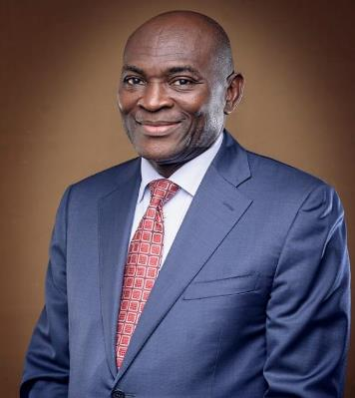
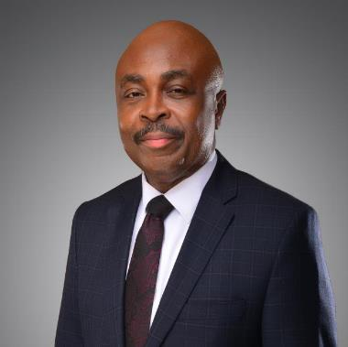
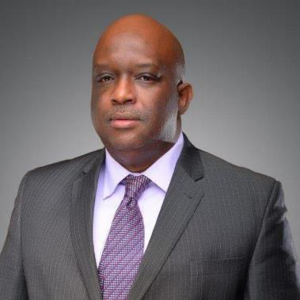
Key Shareholders / Board of Directors
Chairman
Chief Chukwumah. H. Okolo
Vice Chairman
Chukwuemeka Ndu
MD / CEO
Andrew Otike-Odibi
Petra
Properties
Leadway
Assurance Company Ltd.
Out Consortium Finance Limited
Credit Alliance Financial
ABRAAJ Advisers Nigeria Limited
Custodian & Allied Insurance

Slide 35
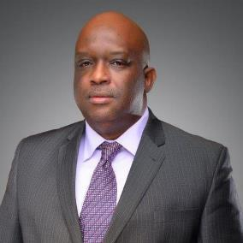
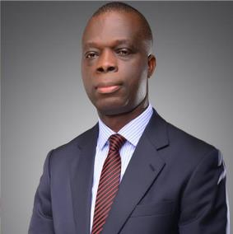
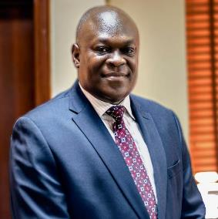
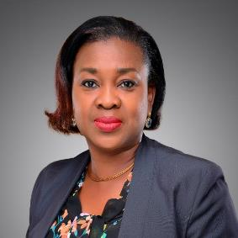
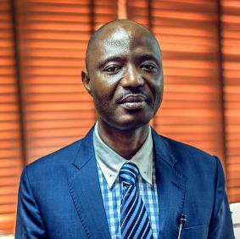
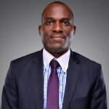
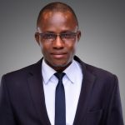
Management
MD / CEO
Andrew Otike-Odibi
Chief Financial Officer
Alex Mbakogu
GM Marine
Wisdom Nwagwu
Group Head HR
Maureen Ogbonna
GM Leasafric Ghana
Kalu. O. Kalu
Head Hertz/Fleet management
Ayodele Johnson Babatunde
Head, C&I Outsource & Training
Chiobi Ikechukwu Edwin
Head Information technology
John Usuanlele
Head Human Resources
Emmanuel Timothy
Head Treasury
Babatunde Oguntunrin
Head Internal control & Quality Assurance Unit
Adetayo Abiodun Olugbenga
Head Finance
Adesoji Aiyeola

Slide 36
Contact
+234 8034070554
andrew.otike-odibi@c-ileasing.com
+234 903 777 5833
alex.mbakogu@c-ileasing.com

